Slide 1


The development of futsal in Portugal and at club level:
the case of SC Braga/AAUM
António Paisana
SCB/AAUM FUTSAL

Slide 2



A case study analysis…
…case studies, like experiments, are generalizable to theoretical propositions and not to populations or universes
…a case study, like the experiment, does not represent a "sample," and the investigator's goal is to expand and generalize theories (analytic generalization) and not to enumerate frequencies (statistical generalization)
…linking data to propositions
…other analytic techniques include explanation-building…
(YIN, 1984)

Slide 3







INDEX
1. Futsal in Portugal
    1.1. Overview
    1.2. Strategic Plan – NSP Futsal
    1.3. Project: +Futsal
2. Futsal at SC Braga/AAUMinho
2.1. The case of AAUM (1994/2007)
2.2. The case of SC Braga (2005/2007)
2.3. The case of SC Braga/AAUMinho (2007/2017)
2.3.1. The protocols
2.3.2. The stakeholders
2.3.3. The organization
2.3.4. Club statistics
2.3.5. Key factors of success

Slide 4






The Portuguese League, presently called SportZone League, was created in
1990 and comprises 14 teams.
The teams that finish in 13th and 14th are automatically relegated to the 2nd division.
The first eight teams play a play off and the winners, up to the final, are those that win two games.
The final is played out of 5 games.
The finalists qualifying for the UEFA Futsal Cup.
The Portuguese League was, at the end of the last season, considered the 3rd best in the UEFA rankings,
behind the Spanish and Russian leagues.
In 6 of the last 8 editions a Portuguese Club played the final four tournament of the UEFA Futsal Cup.
Benfica won the 2009/10 edition and Sporting CP was last year’s defeated finalist.
The 2017/18 tournament will include two Portuguese teams – Sporting Lisbon and
SC Braga/AAUMinho.
Futsal in Portugal
OVERVIEW

Slide 5
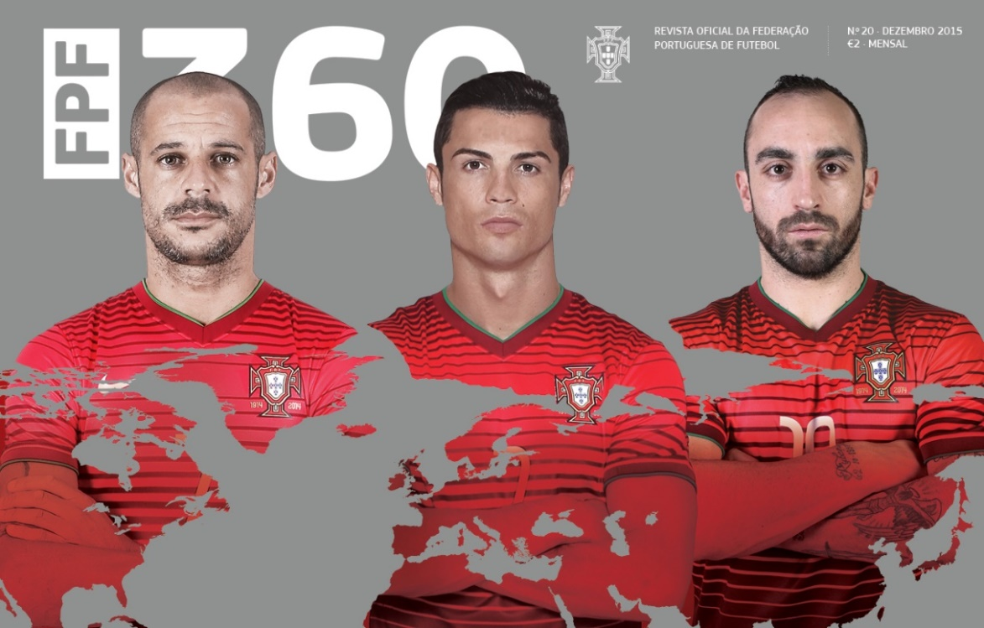
Futsal in Portugal
STRATEGIC PLAN – NSP FUTSAL
Starting point
Design a strategic development plan for Futsal in Portugal (NSP – FUTSAL)
Fernando Gomes, President of FPF, November 2011
Vision: By 2015, Futsal will become the most practised indoors sport in Portugal
Fernando Gomes, Lisbon – 7th December 2011 (inauguration speech)
Source: FPF

Slide 6
Increase number of registered players of all age groups
- primary schools test cases
- universities – include calendar of university competitions in FPF ones
- reduce costs of competing of selected age groups
- incentives for female enrollment
Build a coherent and balanced structure and organization
- flexibility and growth promotion: new communication technologies FPF, DFPF, Clubs
- create new competitions and increase competitiveness in all (reduce number of teams)
Futsal in Portugal
STRATEGIC PLAN – NSP FUTSAL
STRATEGIC PLAN – NSP FUTSAL
5 strategic axes/pillars
Source: FPF

Slide 7
Training of all human resources involved
- players, coaches, referees, officials (more quality of final product)
- design universal principles of play and fundamental skills for each development stage of a futsal player
- allow two extra players U-20 team bench LSZ/D2 teams
- organize professional qualification courses for coaches and for recruiting referees
Management
- better qualified to attract financial resources
- begin quality certification processes: clubs and FPF, DFPF
Communication
- create internal/external communication plan
- promocional DVD
Futsal in Portugal
Source: FPF

Slide 8
Futsal in Portugal
STRATEGIC PLAN – NSP FUTSAL
Performance indicators
TOTAL NUMBER OF AFFILIATES
To increase 5,5 - 12 % in the number of registered players 13,6%
To increase 4 - 7 % in the number of clubs registered 4,9%
To increase 3,5 - 5,5 % in the number of futsal coaches 14,0%
To increase 4 - 7,5 % in the number of futsal referees 5,9%
Source: FPF

Slide 9
Futsal in Portugal
STRATEGIC PLAN – NSP FUTSAL
Performance indicators
PROGRAM: + futsal players
2012
2017
13,6 %
17/12/2011
Begining of Mandate
25/10/2012
Presentation of NSP-Futsal
Source: FPF

Slide 10
Futsal in Portugal
STRATEGIC PLAN – NSP FUTSAL
Performance indicators
PROGRAM: + futsal players - 2011/12 – 1015/16
Female
Total
Male
Male – Young Age Groups
Female – Young Age Groups
12,46%
13,60%
13,81%
26,85%
46,64%
Source: FPF

Slide 11
Futsal in Portugal
STRATEGIC PLAN – NSP FUTSAL
Performance indicators
MISCELANEOUS
2011/12 | SUBJECT | 2016/17
22 | District FAs that have oficial futsal competitions | 22
792 | Clubs that have futsal teams registered in the Portuguese FA | 831
1876 | Teams that compete in oficial futsal competitions organized FPF/DFA – all age groups | 2242
190 | Teams that compete in oficial futsal National competitions (FPF) | 291
28358 | Total number of futsal players registered | 32224
 | Number of UEFA Tournaments won – U -17 M and F | 2
Source: FPF

Slide 12
Futsal in Portugal
STRATEGIC PLAN – NSP FUTSAL
Performance indicators
MISCELANEOUS
2011/12 | SUBJECT | 2016/17
3877 | Number of professionaly qualified coaches | 4420
189 | Number of courses leading to profissional qualification organized for coaches | 242
946 | Number of referees (22 DFA’s) | 1002
9 | Number Official Competitions | 17
1841 | Number of games in national oficial competitions | 2443
1 | Anual events organized for observing young talented players | 3
2 | Number of National Squads | 6
 | Number of participations by Portuguese Coaches and Officials in UEFA Commisions and Work Groups | 5
Source: FPF

Slide 13
Futsal in Portugal
STRATEGIC PLAN – NSP FUTSAL
Performance indicators
PROGRAM: + National Competitions
GENDER | COMPETITION | 2011/12 | 2016/17 | 21017/18
Male | 1st Division | 1 | 1 | 1
 | 2nd Division | 1 | 1 | 1
 | 3rd Division | 1
 | Portuguese Futsal Cup | 1 | 1 | 1
 | Super Cup | 1 | 1 | 1
 | League Cup |  | 1 | 1
 | U- 20 National Championship |  | 1 | 1
 | Juniors B National Championship |  | 1 | 1
 | National Cup – Juniors A | 1 | 1 | 1
 | National Cup – Juniors B | 1 | 1 | 1
 | National Cup – Juniors C |  |  | 1
Female | National Championship |  | 1 | 1
 | Portugal Cup |  | 1 | 1
 | Super Cup |  | 1 | 1
 | National Cup – Senior | 1 | 1 | 1
 | National Cup – Junior A |  | 1 | 1
 | National Cup – Junior B |  |  | 1
Tournaments | Inter DFA – Male | 1 | 2 | 2
 | Inter DFA - Female |  | 1 | 1
TOTAL |  | 9 | 17 | 19
Source: FPF

Slide 14
Futsal in Portugal
STRATEGIC PLAN – NSP FUTSAL
Performance indicators
PROGRAM: Promotion of Young Players - U-20 players used in LSZ/D2
Clubs | 2014/15 | 2015/16 | 2016/17 | TOTAL
CRC Quinta Lombos/Resul | 9 | 7 | 11 | 27
AD Modicus/Glassdrive | 8 | 9 | 6 | 23
Sporting CP | 10 | 7 | 3 | 20
S L Benfica | 12 | 4 | 3 | 19
CCRD Burinhosa | 5 | 6 | 7 | 18
CDR Leões Porto Salvo | 6 | 6 | 4 | 16
CF Os Belenenses | 9 | 5 | 2 | 16
FCU Pinheirense | 6 | 7 | 3 | 16
AD Fundão | 8 | 3 | 4 | 15
Rio Ave FC | 7 | 4 | 3 | 14
Futsal Clube Azemeis/ By Noxae |  | 10 | 2 | 12
GD Fabril | 3 | 5 | 3 | 11
CD Aves | 2 | 6 | 2 | 10
SC Braga | 4 | 2 | 2 | 8
TOTAL | 89 | 81 | 55 | 225
Source: FPF

Slide 15

Futsal in Portugal
STRATEGIC PLAN – NSP FUTSAL
Performance indicators
PROGRAM: Manual for young player´s training development stages (76 pages)
Distributed to every Club affiliated to the FPF
Distributed by the Ministry of Education to every teacher (1414) who integrated futsal in their school´s sports.
Source: FPF

Slide 16
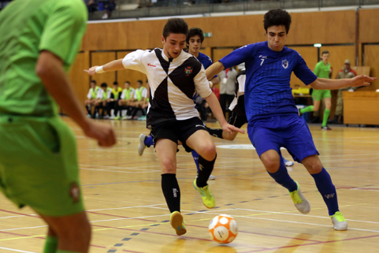
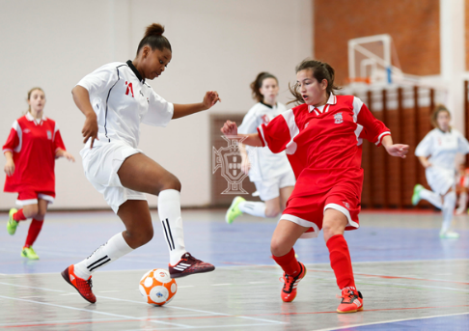
Futsal in Portugal
STRATEGIC PLAN – NSP FUTSAL
Performance indicators
PROGRAM: Observing young talented players – Inter District FA
3 Tournament per season
22 District Squads
1336 Players
138 Games
Male | Female
2012/13: U-15, U-17 | 2012/13: Sénior
2013/14: U-16, U-18 | 2013/14: U-21
2014/15: U-17, U-19 | 2014/15: U-20
2015/16: U-15, U-17 | 2015/16: U-19
2016/17: U-15, U-17 | 2016/17: U-17
2017/18: U-16, U-18 | 2017/18: U-18
Source: FPF

Slide 17
Futsal in Portugal
STRATEGIC PLAN – NSP FUTSAL
Next steps
Strengthen social recognition of the sport in Portugal
Upgrade the level of technical qualifications of coaches training young age groups
Increase the number of female players
Increase the number of players in the U11, U9, U7 ages group
Win an International Competition
Source: FPF

Slide 18
Futsal in Portugal
PROJECT: +FUTSAL – 2015/2016
General
Clubs sign contract arrangements for sustainable growth - grant the FPF the right to sell commercial and TV rights of all live TV matches
FPF invests in Clubs in order to strengthen the sport internally and to improve their operations: €1 million each season 16/17 and 17/18
Source: FPF

Slide 19
Futsal in Portugal
PROJECT: +FUTSAL – 2015/2016
+ FUTSAL and matches more attractive
  Live TV matches - TVI and TVI 24 were the official broadcasters of the league
  (x1 per week)
  Install a removable, attractive floor covering in every Sports Hall for live TV matches
  Install digital line technology around the match floor for sponsors’ promotional ads for live TV matches
Source: FPF

Slide 20
Futsal in Portugal
PROJECT: +FUTSAL – 2015/2016
Obligations - Clubs
Register 7 to 9 locally trained players on the match sheet
Enroll 3 youth teams (A/B/C) in official competitions
Grant the FPF exclusive TV rights for all Club matches (16/17 and 17/18)
Appoint a technical coordinator for youth training development – mimimum qualification: level II
Appoint a public relations official
Source: FPF

Slide 21
Futsal in Portugal
PROJECT: +FUTSAL – 2015/2016
Obligations - Clubs
Guarantee the presence of players and coaches in all media activities as requested (interviews, special programs)
Have a facebook account
Provide the media with club´s match details
Provide special aeras for interviews and match press conferences
Source: FPF

Slide 22
Futsal in Portugal
PROJECT: +FUTSAL – 2015/2016
Media Impact
LEAGUE SPORTZONE (LSZ)
- One live TV match / week
    - Audiences (ex:)
    1st match final - SC Braga/AAUM-Sporting CP – match average 130,000
    3rd match final - SC Braga/AAUM-Sporting CP – match average 190,000
CUP OF PORTUGAL / LEAGUE CUP – FINAL EIGHT ROUND
                - All TV matches live
Source: FPF

Slide 23
Futsal in Portugal
PROJECT: +FUTSAL – 2015/2016
Financial package and other assistance
LEAGUE SPORTZONE (LSZ)
Fixed amount for the participation in LSZ: equal fixed amount
                Prize money for each victory LSZ: equal fixed amount
              Prize money based on past 5 years performance LSZ: 5 groups (1st / 2nd / 3rd and 4th / 5th to 8th / 9th to 14th)
              Prize money based on final league table standings: 5 groups (1st / 2nd / 3rd and 4th / 5th to 8th / 9th to 14th)
CUP OF PORTUGAL – FINAL EIGHT
                Board and lodgings and financial prize
LEAGUE CUP – FINAL EIGHT
                Board, lodgings
Source: FPF

Slide 24



Futsal at SC BRAGA/AAUMINHO
THE CASE OF AAUM (1994/2007)
TWO TEAMS (FPF + University) ONE PROJECT (FUTSAL) – PART 1
FROM
…a squad comprising a mix of non-university and university players
(…1994 to 2001/02)
TO
…one exclusively composed of university players (2002/03 to 2007)

Slide 25
Futsal at SC BRAGA/AAUMINHO
THE CASE OF AAUM (1994/2007)
FPF COMPETITIONS:
- 1st Division – 7 years (1994/95 up to 2000/01)
- 2nd Division – 3 years (2001/02) up to 2003/04)
- 3rd Division – 1 year (2004/05)
- District Division – 2 years (2005/06 up to 2006/07)
UNIVERITY CHAMPIONSHIPS:
- Champions: 1995/1996
- 3rd place 1996/97 and 1998/99

Slide 26

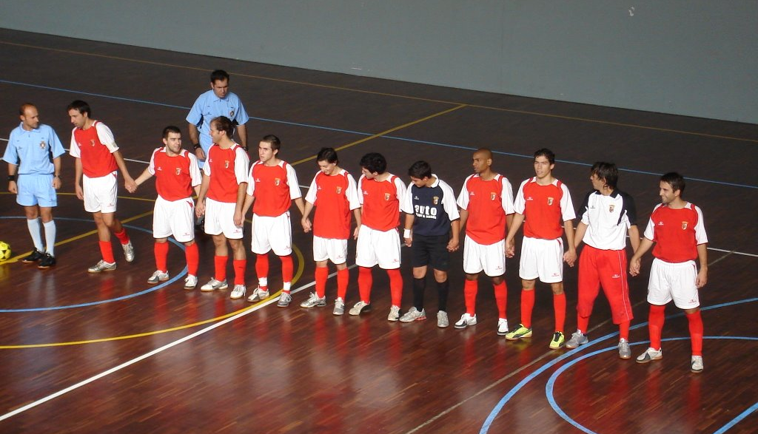
Futsal at SC BRAGA/AAUMINHO
THE CASE OF SC BRAGA (2005/2007)
FPF COMPETITIONS:
- 1st Division – 2 years (2005/06 and 2006/07)
- Cup of Portugal – Runner-up (2006/2007)
2006/2007 - Relegated to Division Two

Slide 27

Futsal at SC BRAGA/AAUMINHO
THE CASE OF SC BRAGA/AAUMINHO (2007/2017)
Sporting Clube de Braga/AAUM Futsal is a futsal team based in Braga, Portugal.
The actual designation was established in 2007 when SC Braga and AAUM (University of Minho Students Union) merged the two futsal teams.
(Wikipedia)

Slide 28




Futsal at SC BRAGA/AAUMINHO
THE CASE OF SC BRAGA/AAUMINHO (2007/2017)
The Protocols
TWO TEAMS (FPF + University) ONE PROJECT (FUTSAL) – PART 2
The August 2007 protocol:
1+1 = 3
AAUM takes over full management responsibilities (SCBraga provides medical and transport)
University of Minho offers use of Sports Hall
From a squad with exclusively university players to a squad with a minimum of 8 university players

Slide 29
Futsal at SC BRAGA/AAUMINHO
THE CASE OF SC BRAGA/AAUMINHO (2007/2017)
The Protocols
The March 2014 protocol (additions):
Regulates the right, and the means, for AAUM to receive sponsorship
Sets out the yearly financial support by SC Braga to the project

Slide 30
Futsal at SC BRAGA/AAUMINHO
THE CASE OF SC BRAGA/AAUMINHO (2007/2017)
The Protocols
The September 2014 protocol:
New naming: SCB/AAUMinho
Payment of University fees
- Any player- undergraduate and integrated masters
- Up to two players - post graduate
Payment of room and board
- Up to two places at halls of residence
- All meals at canteens
Put together and update previous protocols namely:
- Regulate the use of Sports Hall
- Extend benefits to Club officials who are students
- Increase financial support
UMINHO

Slide 31
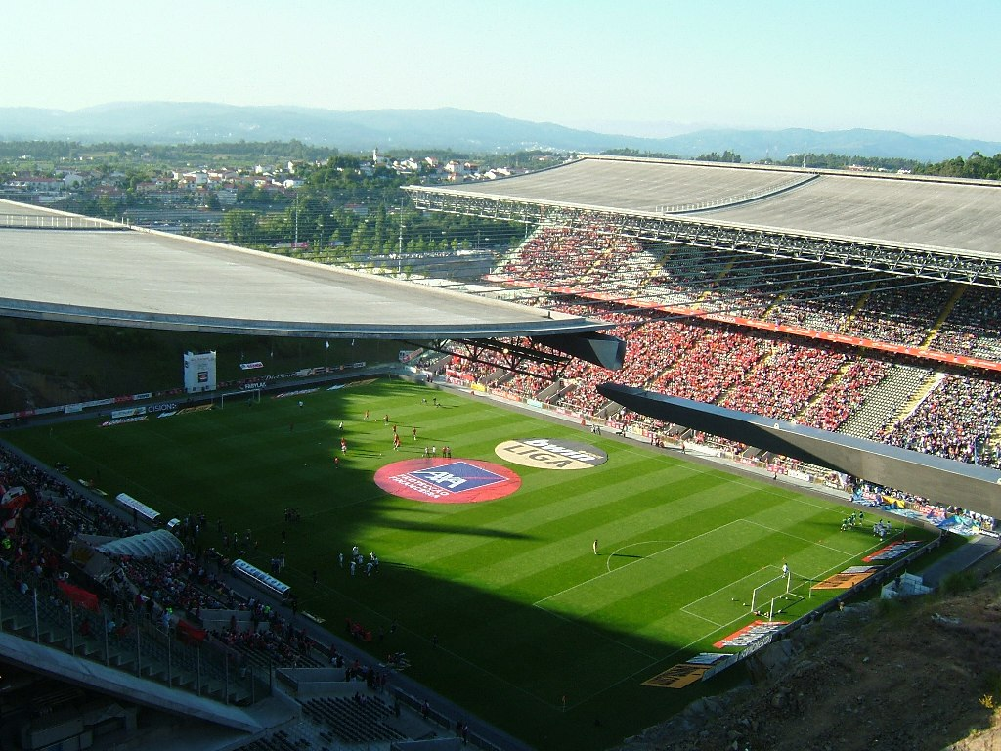
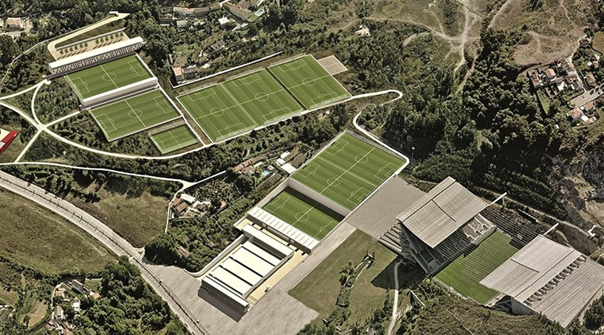
Futsal at SC BRAGA/AAUMINHO
THE CASE OF SC BRAGA/AAUMINHO (2007/2017)
The Stakeholders
Sporting Clube de Braga ( www.scbraga.pt ) - video

Slide 32
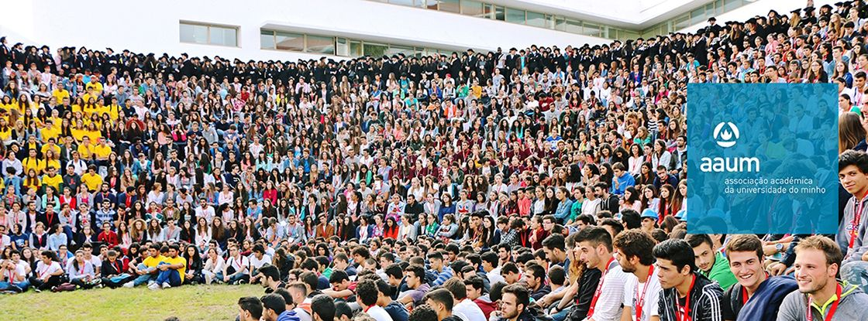
Futsal at SC BRAGA/AAUMINHO
THE CASE OF SC BRAGA/AAUMINHO (2007/2017)
The Stakeholders
Associação Académica da Universidade do Minho (www.aaum.pt)
The University of Minho Student´s Union was created on the 19th of December 1977 and represents all Minho University students at all levels and areas – social, academic – and participates in all National University Sports Competitions

Slide 33
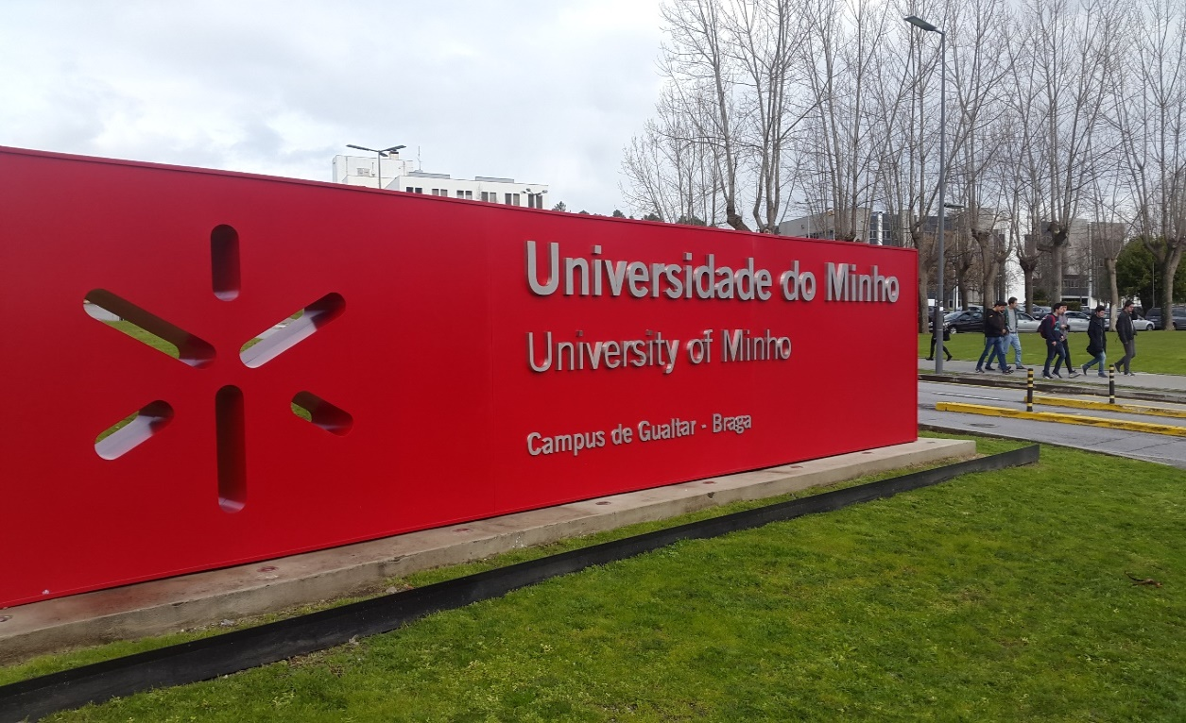
Futsal at SC BRAGA/AAUMINHO
THE CASE OF SC BRAGA/AAUMINHO (2007/2017)
The Stakeholders
Universidade do Minho (www.uminho.pt) - video
19,500 total students
2,000 PhD students
1,300 teaching staff 100% PhD holders
Among the 600 best in the world, according to the Times Higher Education
Among the 100 best in the world, with less than 50 years of existence, according to the Times Higher Education
Best Portuguese university in the CWT Leiden ranking

Slide 34
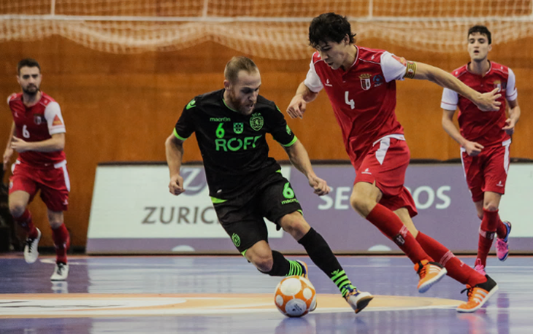
Futsal at SC BRAGA/AAUMINHO
THE CASE OF SC BRAGA/AAUMINHO (2007/2017)
The Organization
Organizations are not anarchic units – they have structures (in this case based on functions i.e. grouping people around a set of coherent functions or activities), and mechanisms to bring these efforts/work together again (hierarchy, targets).
Also, they have norms of conduct to make life inside uniform – the case of a REGULATORY FRAMEWORK
The Structure (main team)
Board of Directors
General Director (the liaison person) | 1
AAUM President | 1
SCB President | 1
Staff
Operations | 1
Financial | 2
Communication | 2
Tecnhical staff | 3
Medical Staff | 1

Slide 35
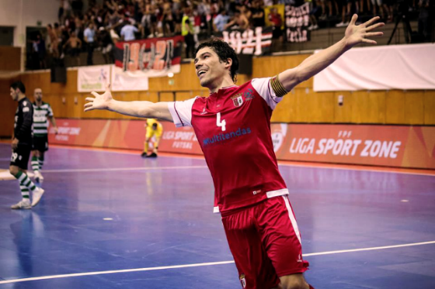
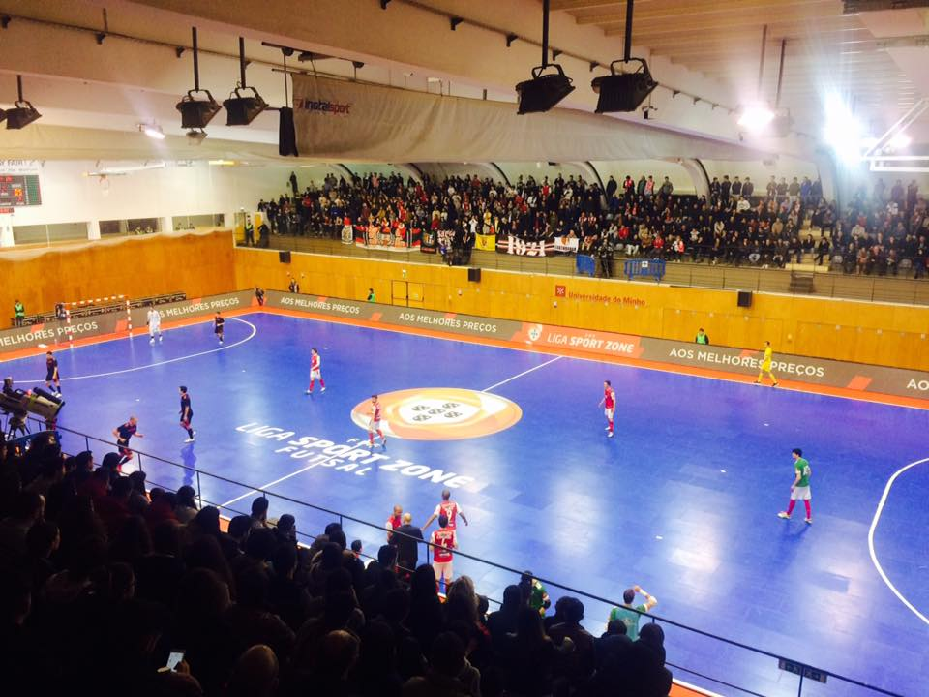
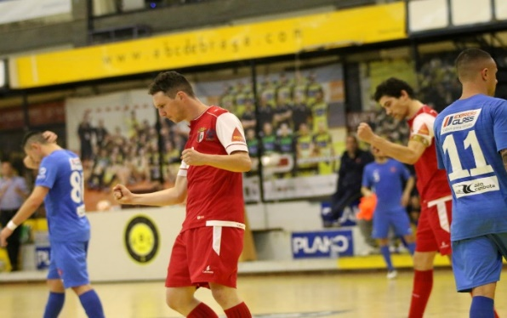
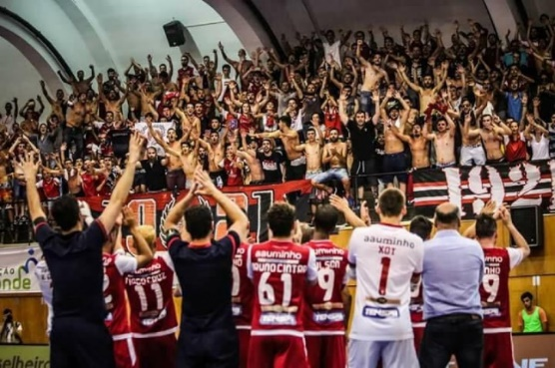
Futsal at SC BRAGA/AAUMINHO
THE CASE OF SC BRAGA/AAUMINHO (2007/2017)
Club Statistics
National FPF Competitions
LEAGUE
- Runner-up (1): 2016-17
- Semi-finals (3): 2013–14, 2014–15, 2015-16
PORTUGAL CUP
- Runner-up (2): 2006–07, 2012–13
SUPERCUP
- Runner-up (2): 2006–07, 2012–13
National University Competitions
National Champions
- 2009-10
- 2010-11
- 2011-12
- 2012-13
- 2014-15
- 2015-16

Slide 36
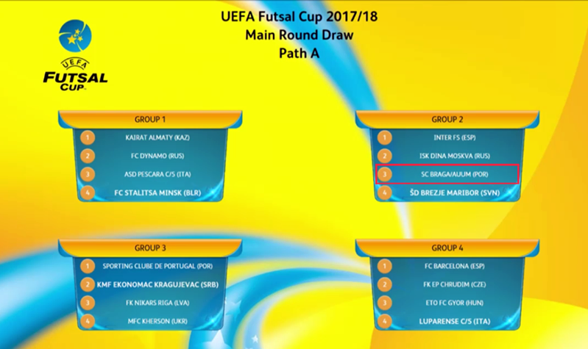
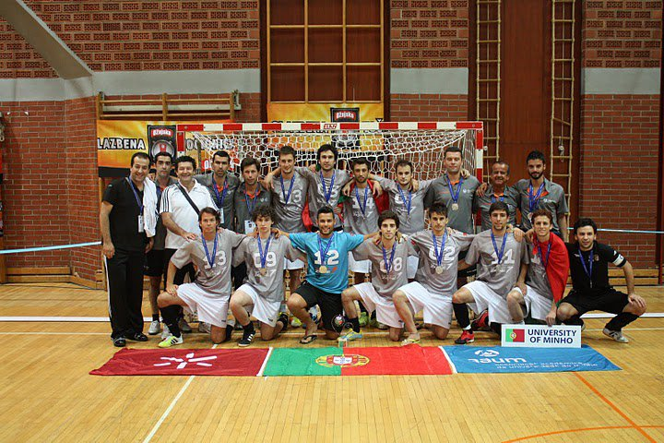
Futsal at SC BRAGA/AAUMINHO
THE CASE OF SC BRAGA/AAUMINHO (2007/2017)
Club Statistics
International Competitions
2017/2018 UEFA Futsal Cup
- Main Round (Group 2)
Inter FS
MFK Dina Moskva
Brezje Maribor
SC Braga/AAUM
European University Championship
Runner-up
- 2009/2010 (Zagreb)
- 2011/2012 (Cordoba)

Slide 37
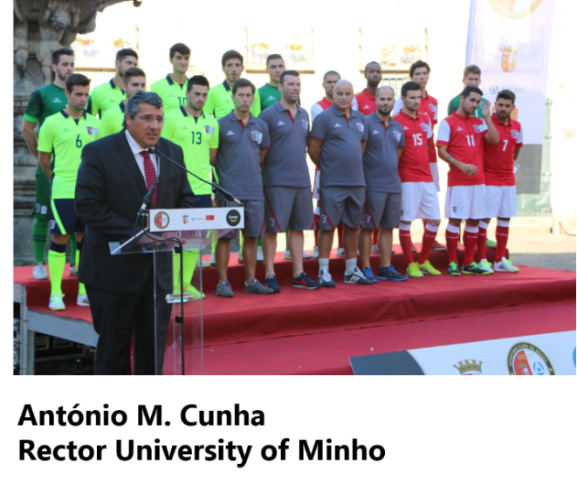

Futsal at SC BRAGA/AAUMINHO
THE CASE OF SC BRAGA/AAUMINHO (2007/2017)
Key Factors of Success
EXTERNAL ASPECTS
Environmental aspects: University context
- Proximity to knowledge creation context: part of numerous scientific projects in areas like textiles, eating habits, communication
- Mix of players who are graduates, others graduating, and non-students
- Officials are all qualified people (Masters degrees…)
The Club
A singular project aggregating 3 major Institutions
. SCBraga (fans) offers passion
. AAUM offers proximity to the Academia and irreverence
. UM rigor, discipline, applied knowledge
Diverse composition (students, academics, club members) attractive for investors and sponsors…

Slide 38
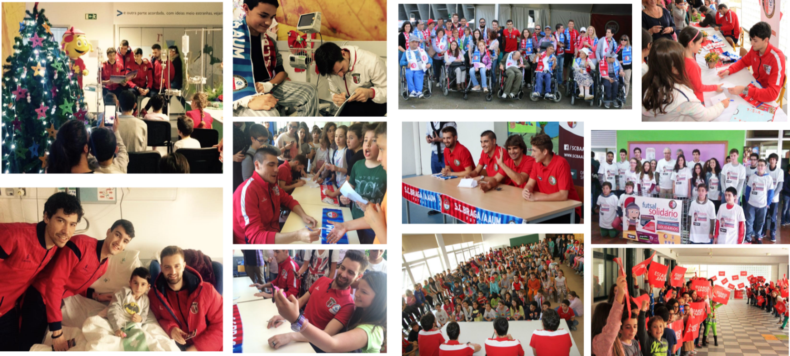
Futsal at SC BRAGA/AAUMINHO
THE CASE OF SC BRAGA/AAUMINHO (2007/2017)
Key Factors of Success
EXTERNAL ASPECTS
Community proximity
- Regular visits to schools
- Regular visits to hospitals
- Facebook
Institution | Link | Followers
SC Braga/AAUM Futsal | www.facebook.com/scbaaumfutsal/ | 10k
SC Braga | www.facebook.com/sportingclubedebraga/ | 274k
AAUM | www.facebook.com/aauminho/ | 38k
Universidade do Minho | www.facebook.com/uminhooficial/ | 73k

Slide 39
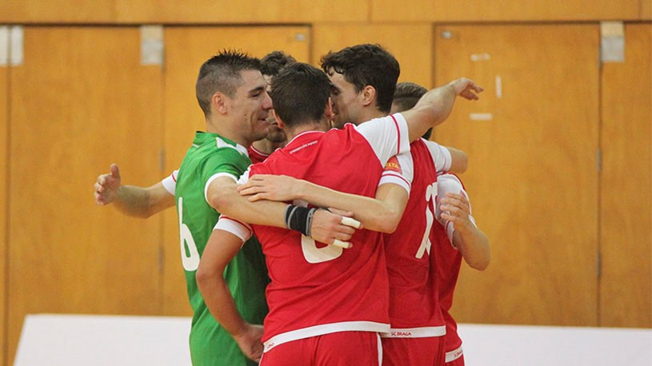
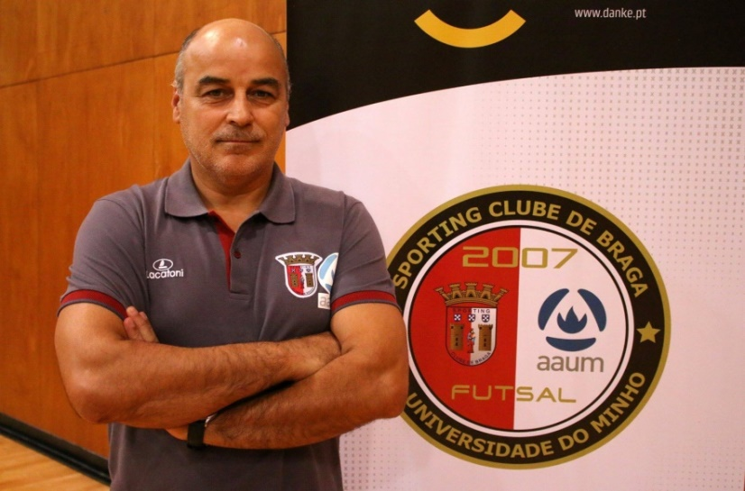
Futsal at SC BRAGA/AAUMINHO
THE CASE OF SC BRAGA/AAUMINHO (2007/2017)
Key Factors of Success
INTERNAL ASPECTS
Management principles
- Commitment is to the collective
- Economies of experience matter
… to understand…the needs approach
… to gain trust by anticipating and acting
- (Always) add value and provide a sense of direction
… use experience under stressful situations
… use intelligence in less stressful situations
- Cognitive competencies as important as technical competencies
- Crucible factors
- Great coach competency: young average age (23,64 yrs)

Slide 40
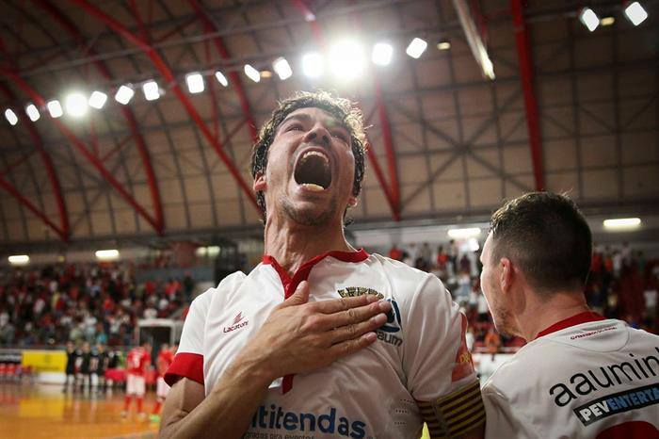
.
THANK YOU

