Slide 1

WA STATE FUTSAL CENTRE
The only Futsal dedicated centre in Western Australia.

Slide 2
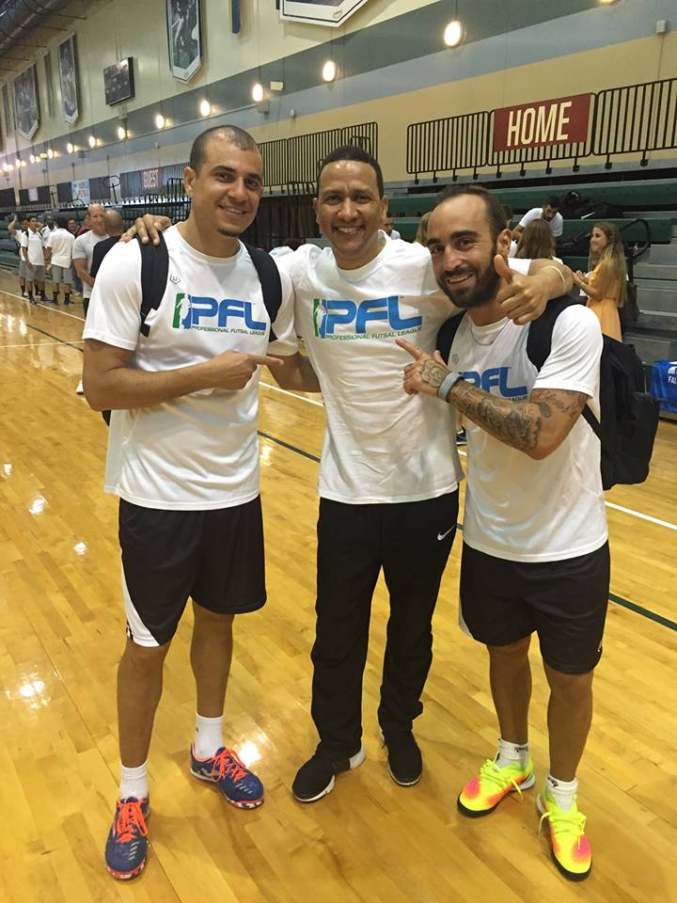
EL ABRAHAMS
WA STATE FUTSAL CEO & SFL PRESIDENT

Slide 3
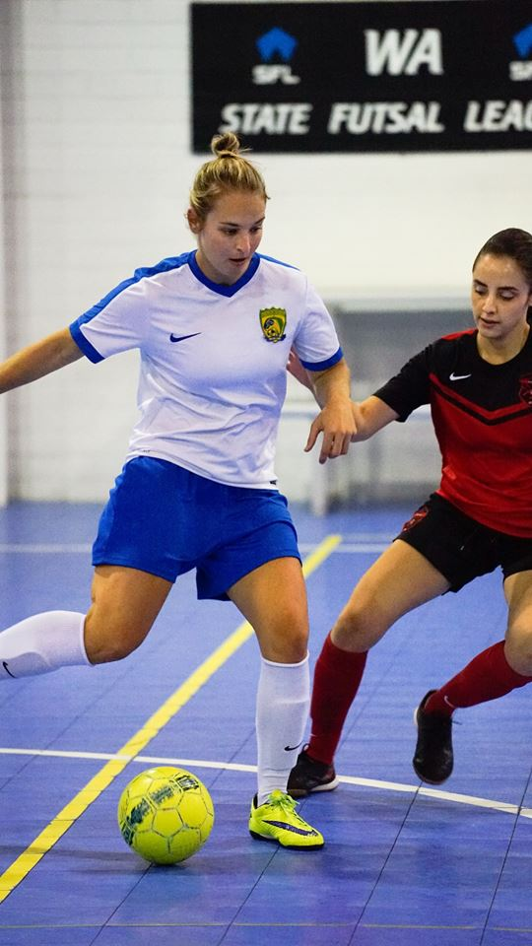
SUMMARY
Who we are
Our Mission
Challenges
Our Location
Elite Leagues
Futsal Careers
Social Leagues
Junior Programs
Academies
Our Management
Partners and Sponsors
Sponsorship Opportunities
Our brands yesterday and today
Who we will be tomorrow

Slide 4
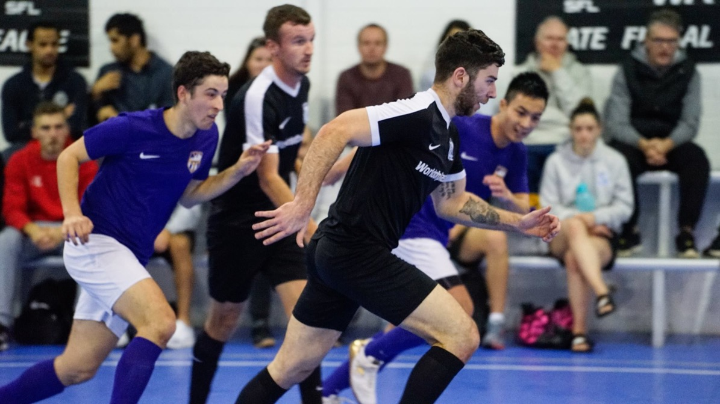
WHO WE ARE
IT’S ALL ABOUT FUTSAL.
WA State Futsal was established in June 2013 and opened the doors for Western Australia’s
first dedicated Futsal centre named the “WA State Futsal Centre” in December 2013.
We provide opportunities for people of all ages and skill levels to participate in Futsal, from grassroots through to elite local, national and international competitions.

Slide 5
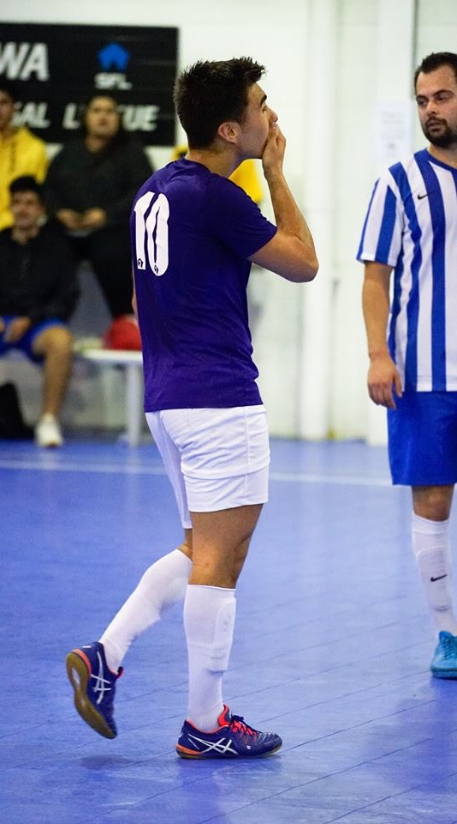
CHALLENGES
NOBODY SAID IT WAS EASY.
Competitors
Other sports
Football
No history
Location
Lack of support
Seasons
Lack of exposure
Lack of federation support
Indoor soccer vs Futsal
Finance

Slide 6
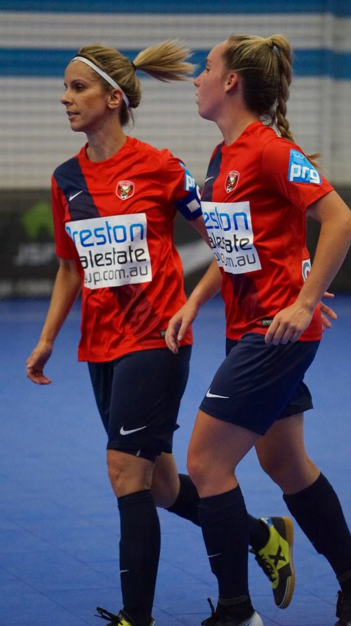
OUR MISSION
FUTSAL IS NOT “JUST A GAME”.
We provide opportunities to players through competitions, training sessions, entry to interstate and international competitions, training courses for referees and coaches and we recently hosted one of the major national Futsal tournaments in Australia.
We are expanding our range of services with a major focus on education and training and partnering with a multitude of international Futsal Associations.

Slide 7
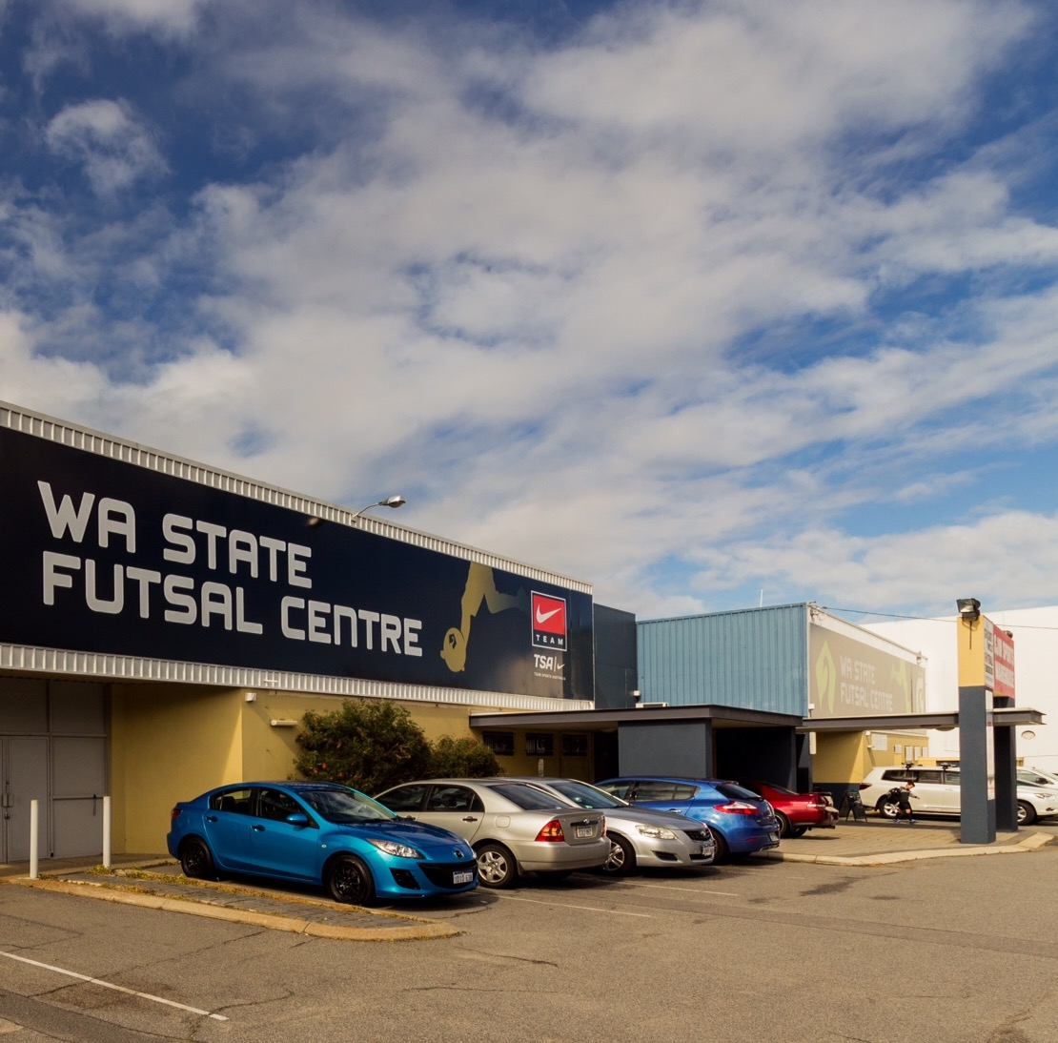
WHERE ARE WE
FUTSAL CONNECTS PEOPLE IN THE COMMUNITY.
Our current operation is the WA State Futsal Centre located 15 minutes south of Perth CBD. The Perth South operation has 4 active Futsal courts. We are planning to open another 2 centres by the end of 2018 in the Perth Metropolitan area (Perth Central and Perth North).
Opening another 2 centres will give us the opportunity to cover the whole Perth Metropolitan Area. We are in contact with other cities within the state to start developing Futsal programs in their communities.

Slide 8
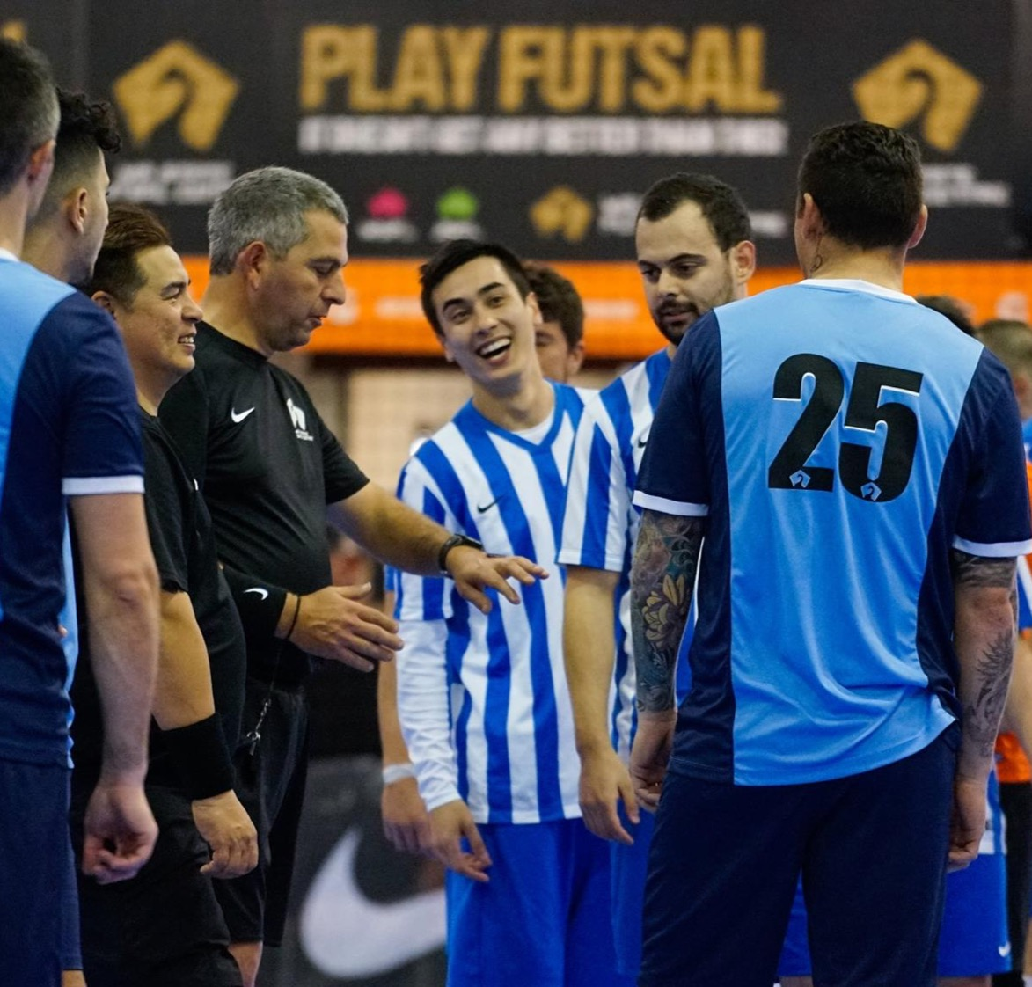



ELITE LEAGUES
CREATING CLUBS, NOT TEAMS.
The Elite Leagues are composed of SFL (Men), WSFL (Women) and JSFL (Juniors).
In the new season, 17 clubs and 114 teams will compete across 17 different divisions.
In these leagues the top teams from WA compete every Friday and Saturday at the WA State Futsal Centre. SFL and WSFL games will be live streamed and commentated professionally from next season, starting in October.

Slide 9
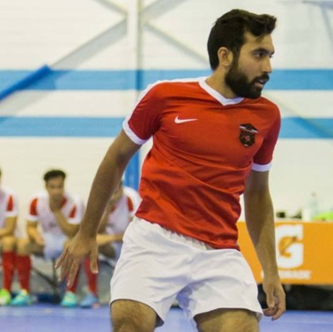
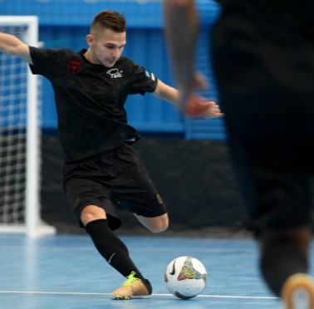
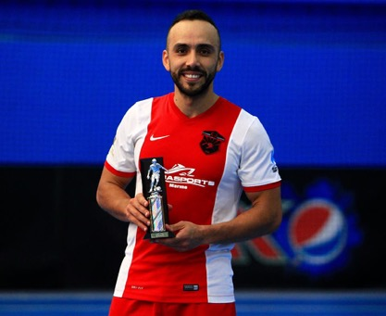
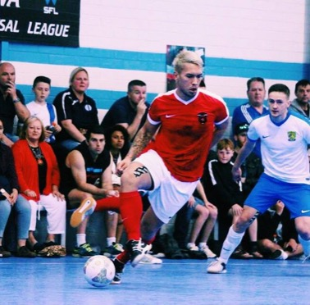
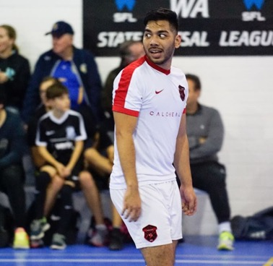
LAUNCHING FUTSAL CAREERS
NESTOR FONSECA
SALMAN ALHAMMADI
SAETA FC (COLOMBIA)
PARIS SAINT OUEN FC (FRANCE)
GALAXY FC (AUSTRALIA)
KAZMA FC (KUWAIT)
YAZID OMAR
MELAKA UNITED (MALAYSIA)
MALAYSIA NATIONAL TEAM
RICO ZULKARNIAN
FARIS NOOR RANI
KUANTAN RANGERS (MALAYSIA)
WALES NATIONAL TEAM
MELAKA UNITED (MALAYSIA)

Slide 10
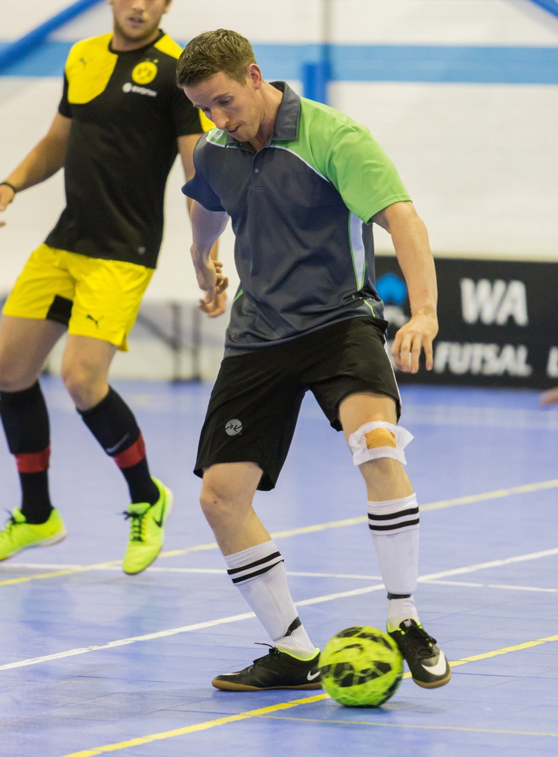



SOCIAL LEAGUES
FUTSAL IS FOR EVERYONE.
The Social Leagues are composed of MSL (Men), WSL (Women) and JSL (Juniors).
In the new season 170 teams will compete in 12 different divisions from Monday to Thursday, catering for all skill levels and age groups.
We have started training programs and clubs for beginners, with a major focus on junior development, in order to create futsal players and be able to use this as a feeder for the elite leagues.

Slide 11
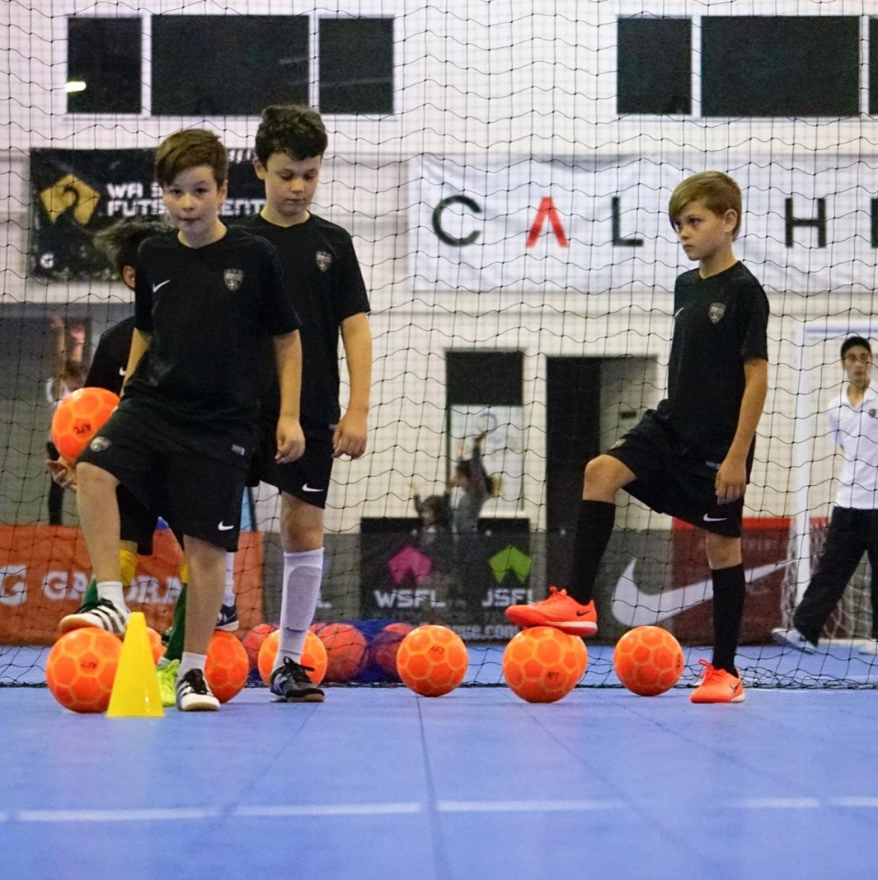



JUNIOR PROGRAMS
BUILDING THE CHAMPIONS OF TOMORROW.
One of our major focuses is the development of our junior players, and the same is for most of the clubs playing in the WA State Futsal Leagues.
Our programs cater for all skill levels and age groups, and our goal is to create a pathway in Futsal for all juniors who want to become Futsal players.
At the moment we have 68 teams in competing in 11 different Elite competitions and 74 teams competing in 10 different Social competitions. Our goal is to double the junior teams and clubs by the end of 2018.

Slide 12
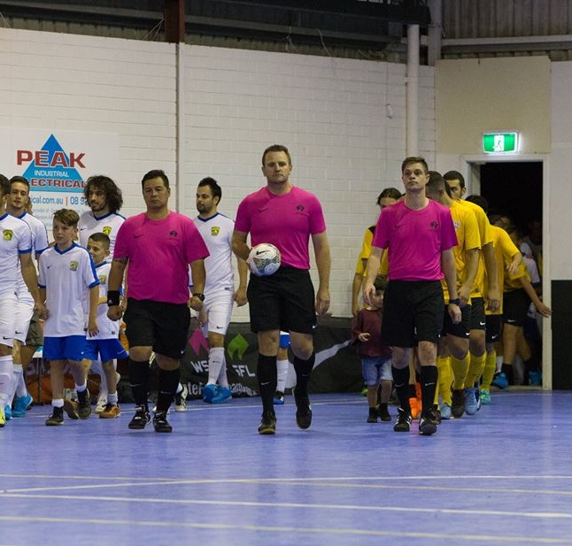



OUR ACADEMIES
CHASING QUALITY IN FUTSAL.
WA State Futsal is putting a major focus on training and education. The Referee Academy has been developed after the successful 2016 Referee course with the most outstanding Australian Futsal referee Chris Colley to increase the number of referees for the Elite and Social leagues played at the WA State Futsal Centre.
The Futsal Academy is composed of all the junior programs we are running at the moment plus an advanced futsal training for elite players.
The coaching academy will start late 2017, and will raise the quality of coaching across all leagues.

Slide 13
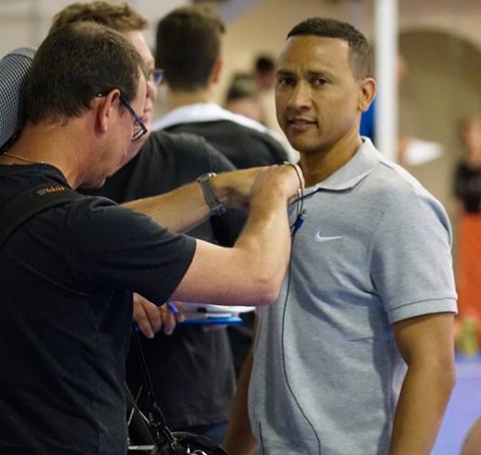
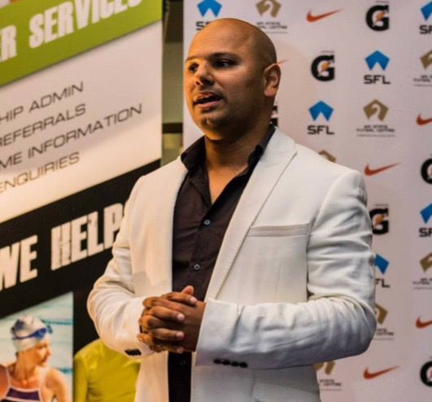
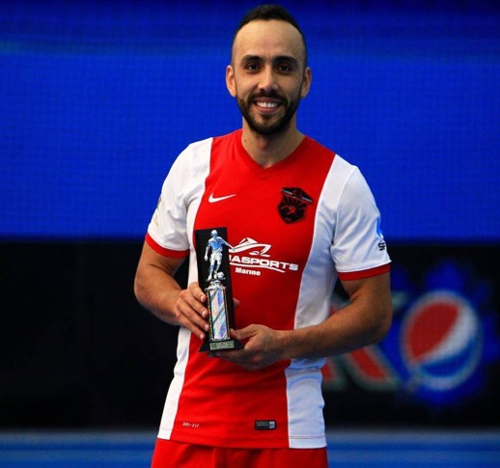
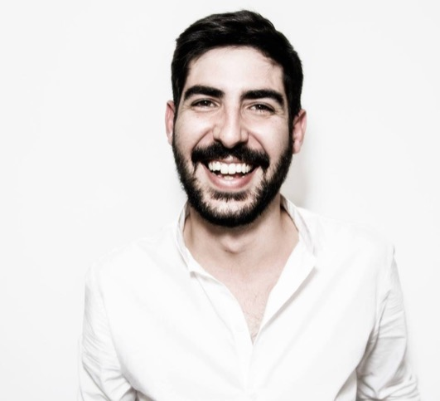
OUR MANAGMENT
A PROFESSIONAL APPROACH IN FUTSAL.
At WA State Futsal everything is done professionally.
Eldon Abrahams and Raj Albuquerque founded WA State Futsal in 2013. They believed in the dream to build the home of Futsal in Western Australia, creating the perfect place for this sport.
Nestor Fonseca helped build our junior leagues and junior training programs, and is part of our media team. He is now working full time to help develop WA State Futsal, our new brand and improve the leagues and our academies.
Roberto Boi is our digital marketing manager at WA State Futsal. He joined us in early 2017 after a background as Head of Digital Marketing in a digital agency. He is focusing on building our digital presence and has created an online lead generation funnel to nurture our leagues and programs.

Slide 14
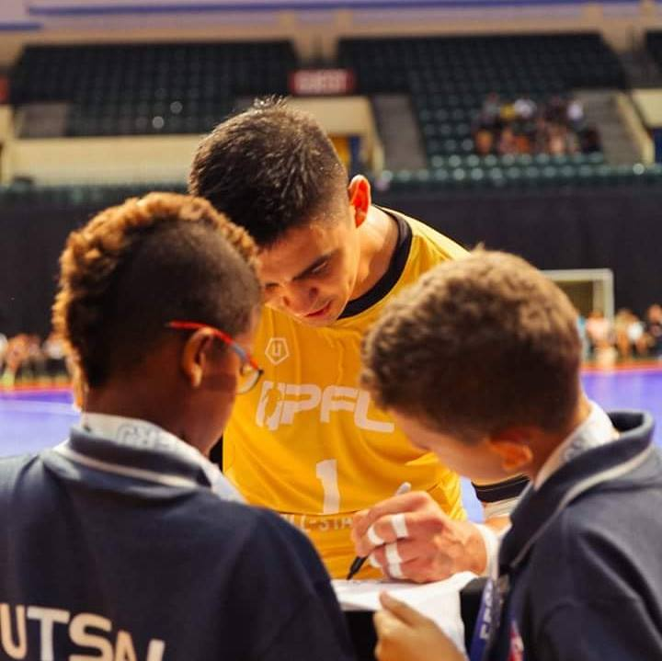




OUR PARTNERS
KICKING GOALS TOGETHER IN FUTSAL.
WA State Futsal is a partner of USA Futsal, Professional Futsal League, Futsal OZ and Football West.
We are constantly working with the same goal in mind, which is developing Futsal all around the world. We are in contact with other international Futsal Associations and we hope to extend our partnerships to other countries all over the world.

Slide 15
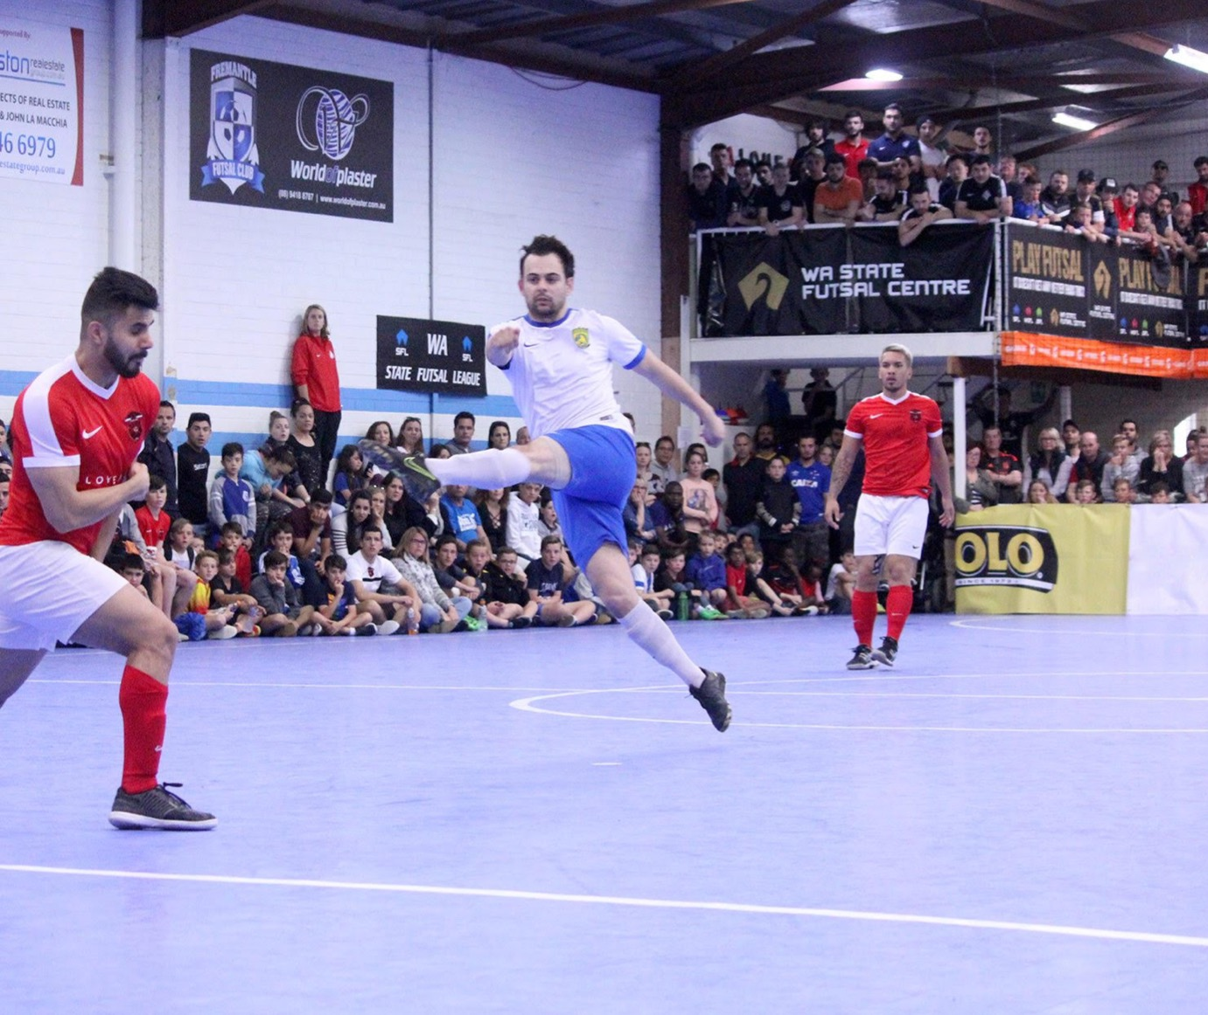




OUR SPONSORS
SUPPORTING US DURING OUR JOURNEY.
Since 2014, WA State Futsal has been sponsored by four major international brands: Nike, Schweppes, Pepsi and Gatorade.
Three of these major sponsors are highlighted in our premier leagues: Nike SFL, Gatorade SFL Draft and Pepsi WSFL.
More than 15 local businesses are supporting our Futsal Centre due the great media exposure, giving ongoing benefits to our 3,000+ members.

Slide 16
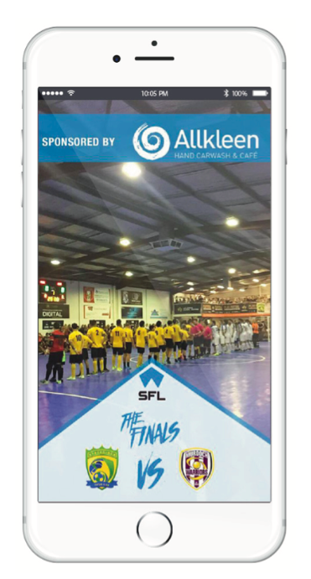
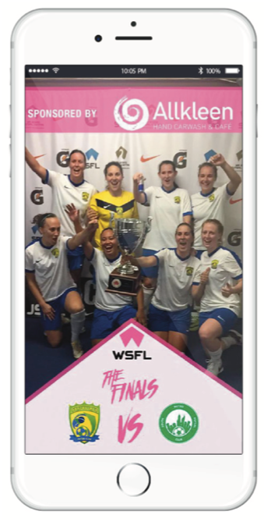




SPONSORSHIP
OPPORTUNITIES
SUPPORTING EACH OTHER.
Customised packages available
Centre or league sponsorship packages
Co-naming rights
Media coverage, sponsored posts, video advertising
Court signage
Live streaming advertising
Social media advertising
Marketing consultation
VIP access and benefits

Slide 17




YESTERDAY
WHO WE WERE BEFORE.

Slide 18



TODAY
WHO WE ARE NOW.

Slide 19
WHO WE WILL BE
TOMORROW

Slide 20

OCTOBER 2017
CHANGING THE GAME.
profutsal.com.au

